Slide 1

Dev Mobile Project: Twitter (X)
Group 4 : Lý Nhật Huy (Cap)
Tạ Minh Đức
Nguyễn Như Duy
Lê Tuấn Đạt
Nguyễn Tiến Đạt
Nguyễn Minh Hoàng (Presenter)

Slide 2
Table of contents
01
02
03
04
05
06
Introduction
Architecture
Activities
Optimization
Conclusion
Demo

Slide 3


01
Introduction

Slide 4

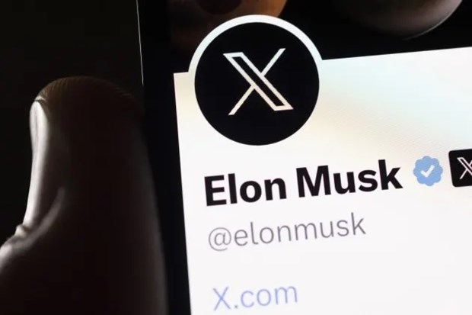
What is X ?
X is an online social network designed for people to connect, communicate, and share content with others.

Slide 5
Why do we need it ?
Real-time Communication
Tweets
Share and discover real-time information
Update news, livestream, trending topics,...
Short, impactful messages that can include multimedia.
Interact with everyone
Global Connection
Provide many functions to interconnect
Cross-platform application approved in many countries.
Huge community

Slide 6
02
Architecture

Slide 7
User Interface (UI) Layer
Activities and Fragments
XML Layouts

Slide 8
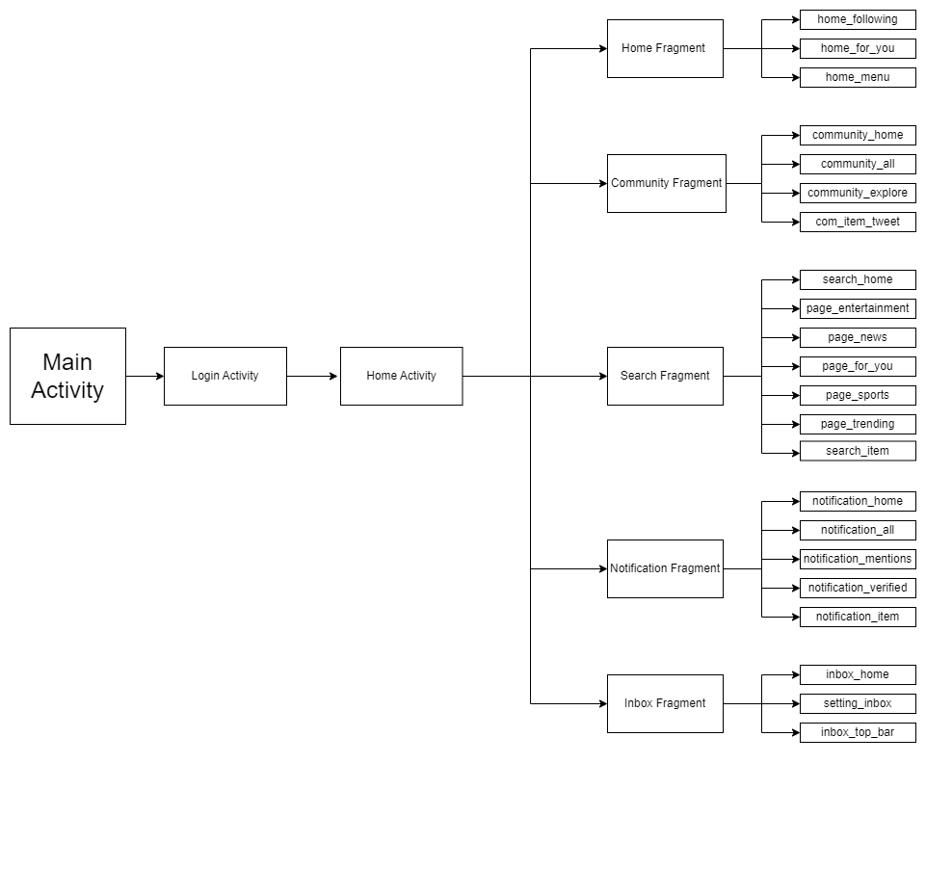
UI Layer Figure

Slide 9
03
Activities

Slide 10
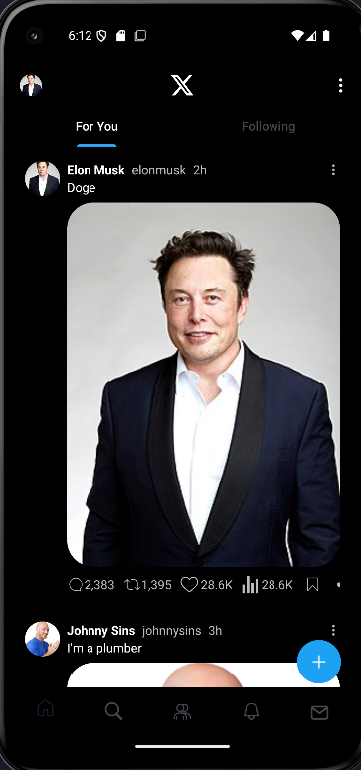

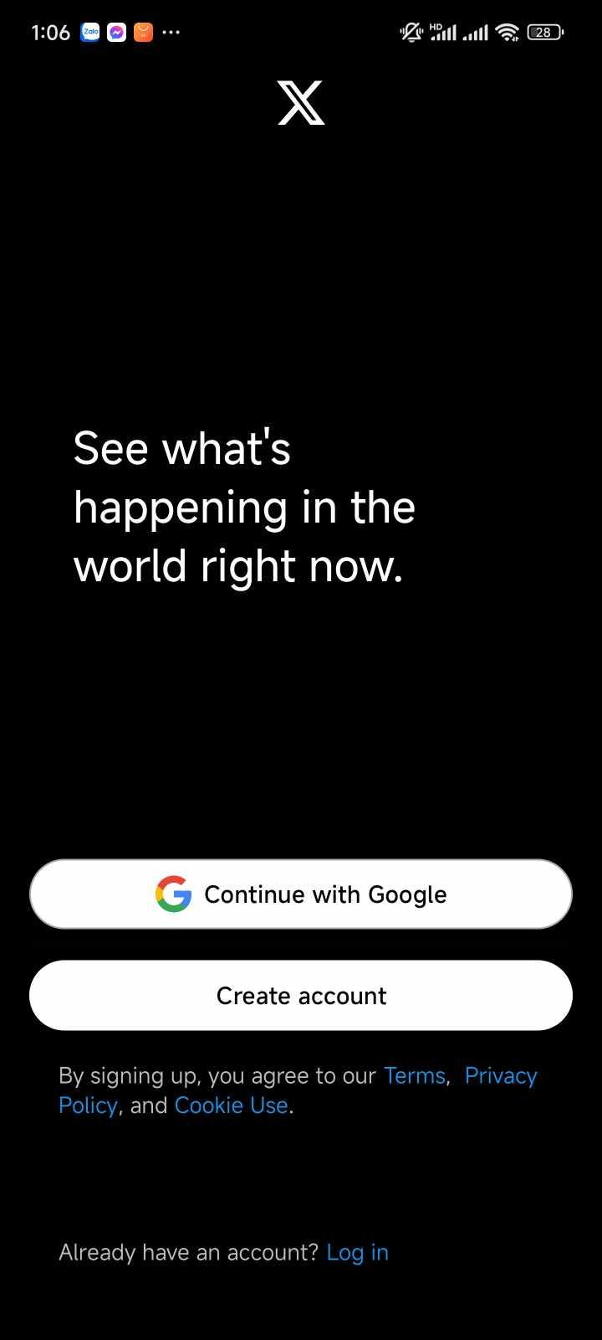
Three Main Activities
Home
Main Activity
Login
To run Fragments
Screen with X’s Logo when open app
User’s Authentication

Slide 11
Five Main Fragments
Home
Community
Search
Notification
Chat Box

Slide 12
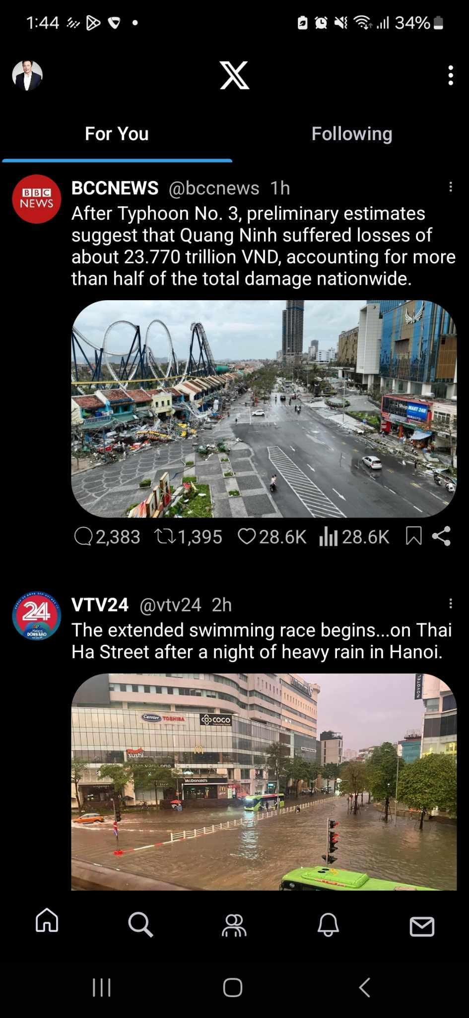
Home
Post constructor: includes profile picture, username, description and image
Interact with comment, heart and bookmark button

Slide 13
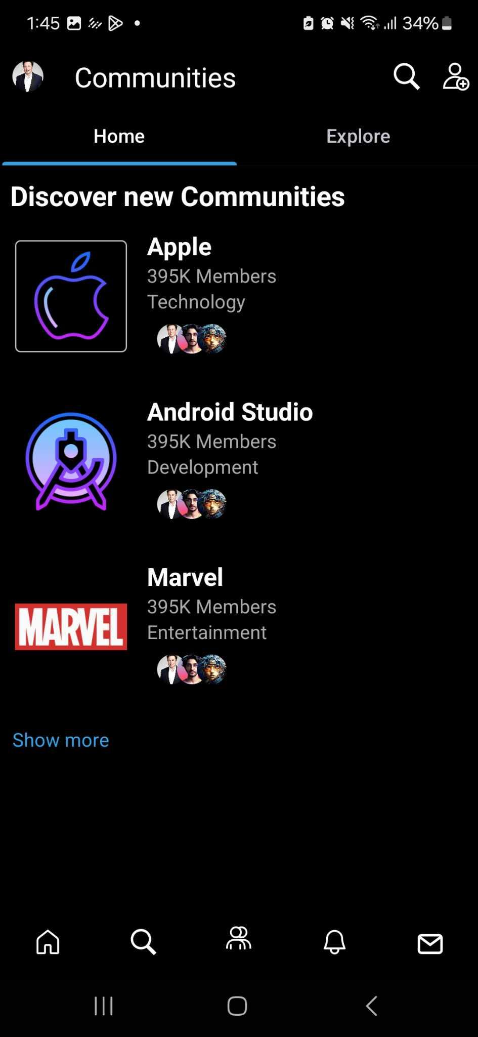
Community
Contain: Home page, Explore page and category
UX: Flip through Explore page and Home page, scroll horizontal posts

Slide 14
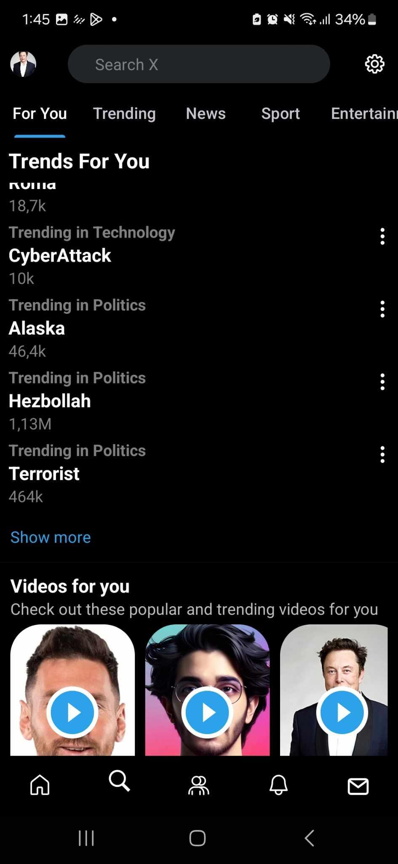
Search
Suggested Topics, content, video that many people search for or user may like

Slide 15
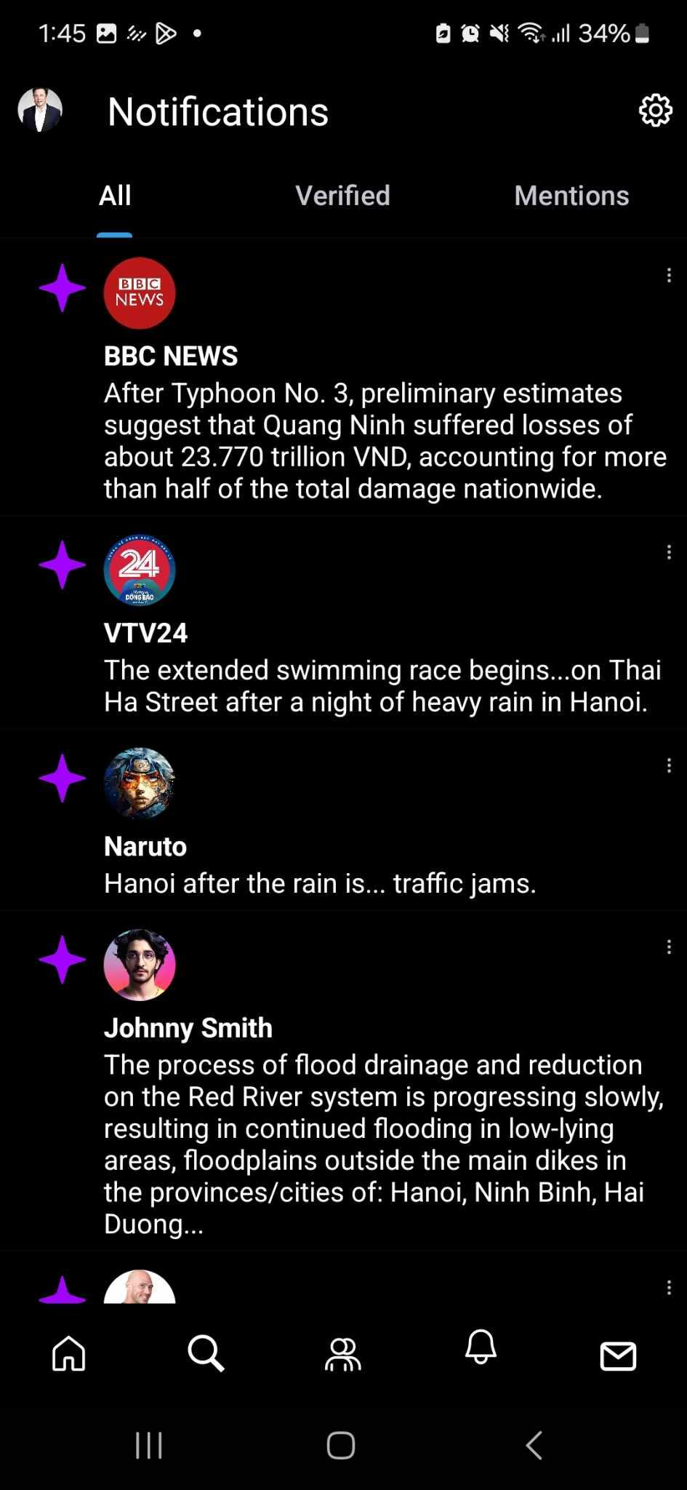
Notification
Notification for Tweets
Notification UI

Slide 16
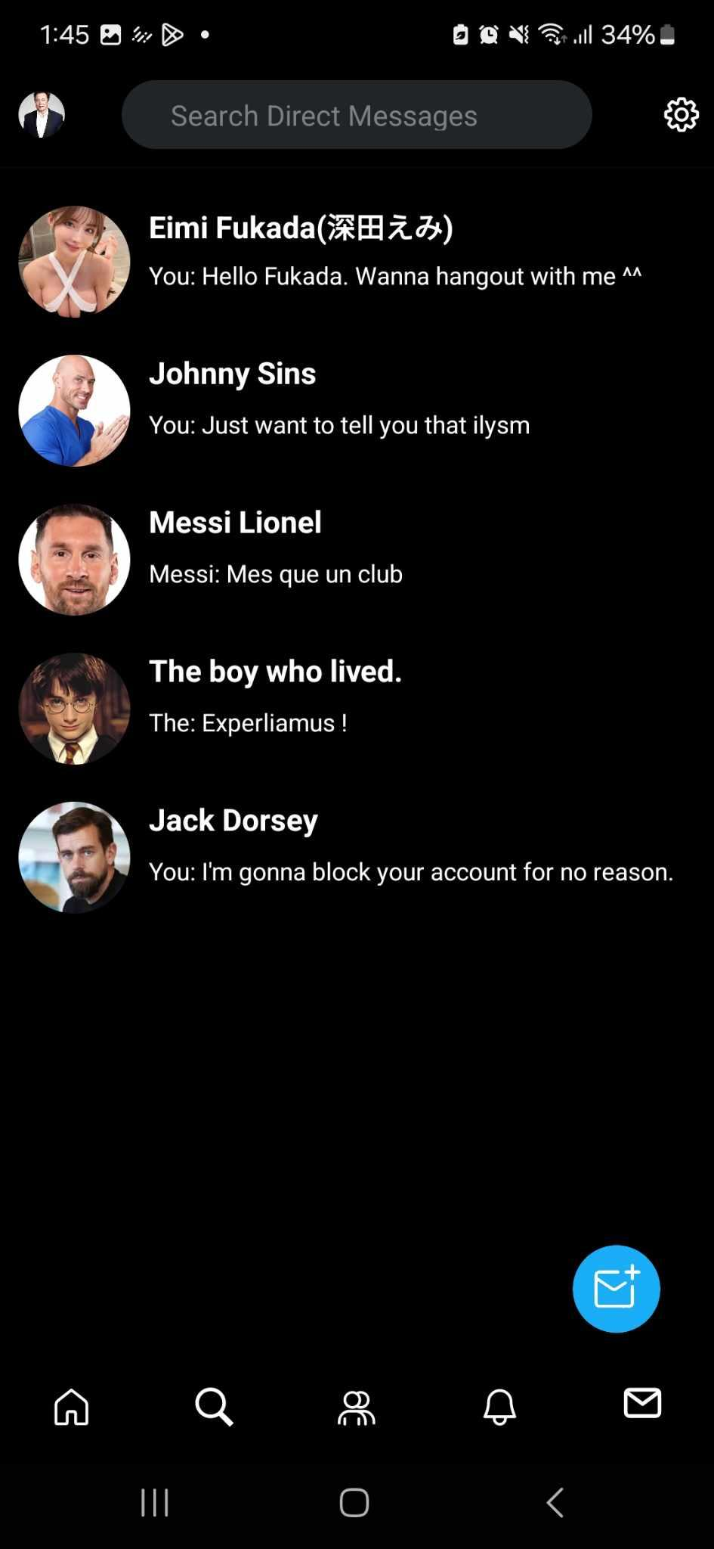
Chat Box
Search bar for direct messages
Inbox UI

Slide 17
04
Optimization

Slide 18
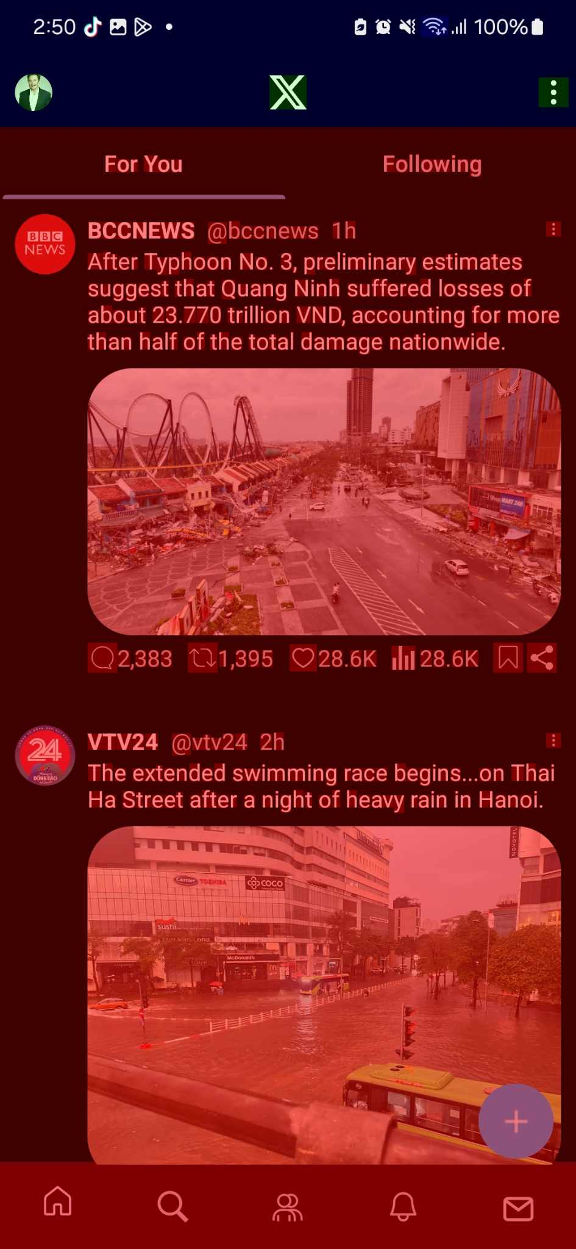
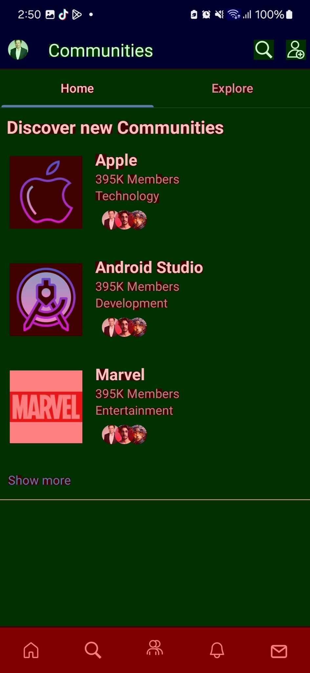
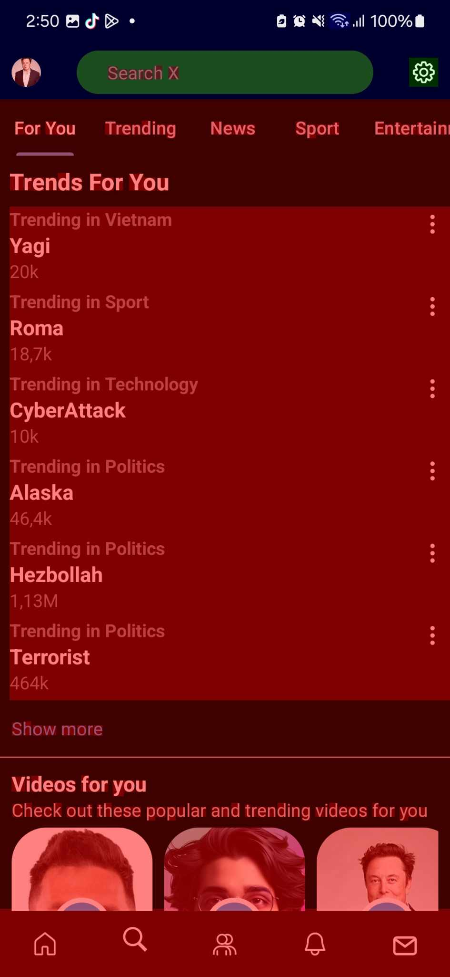
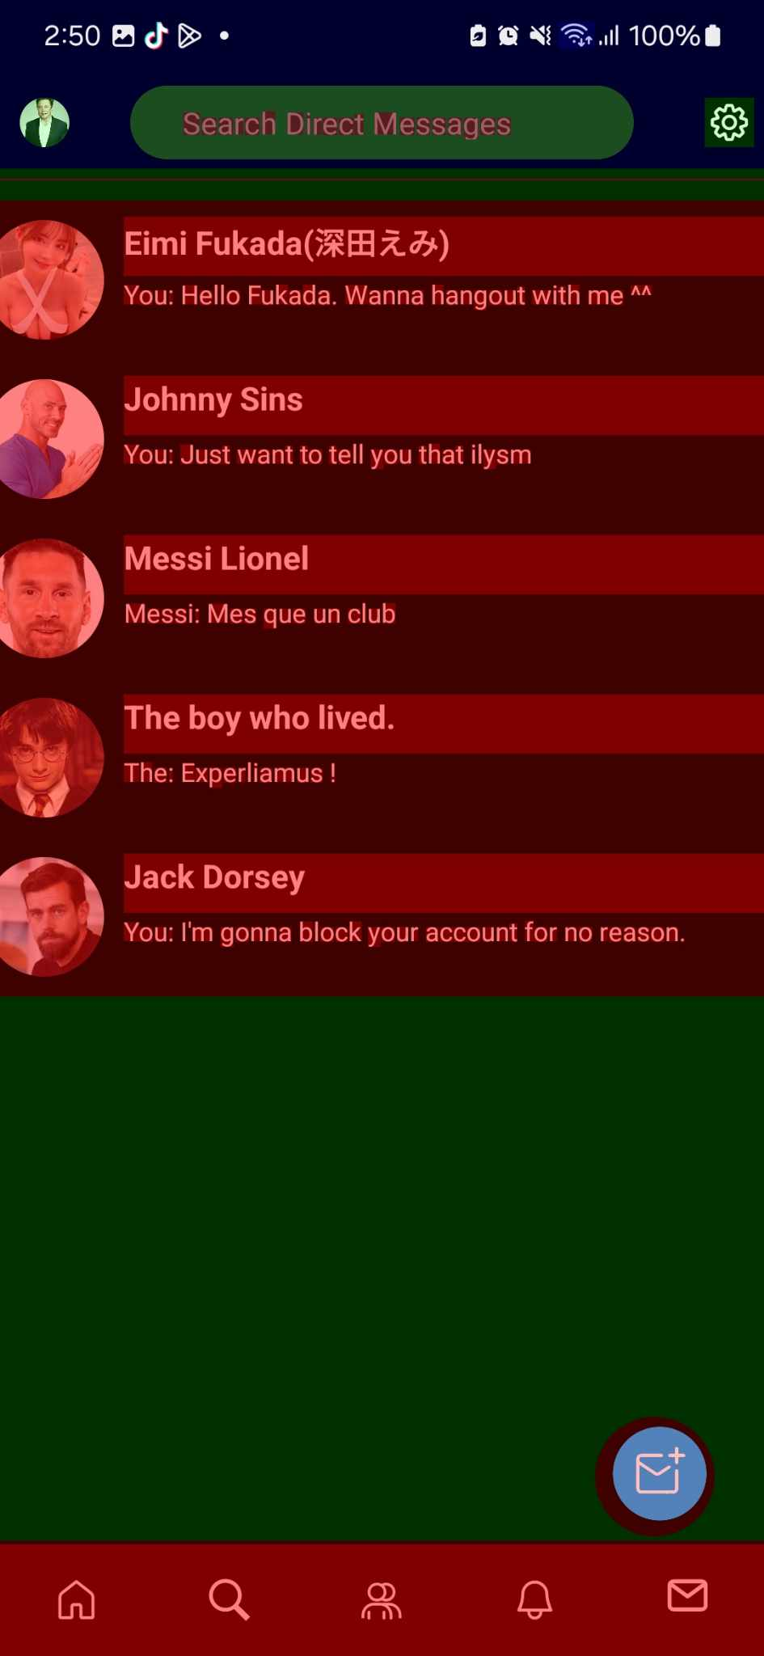
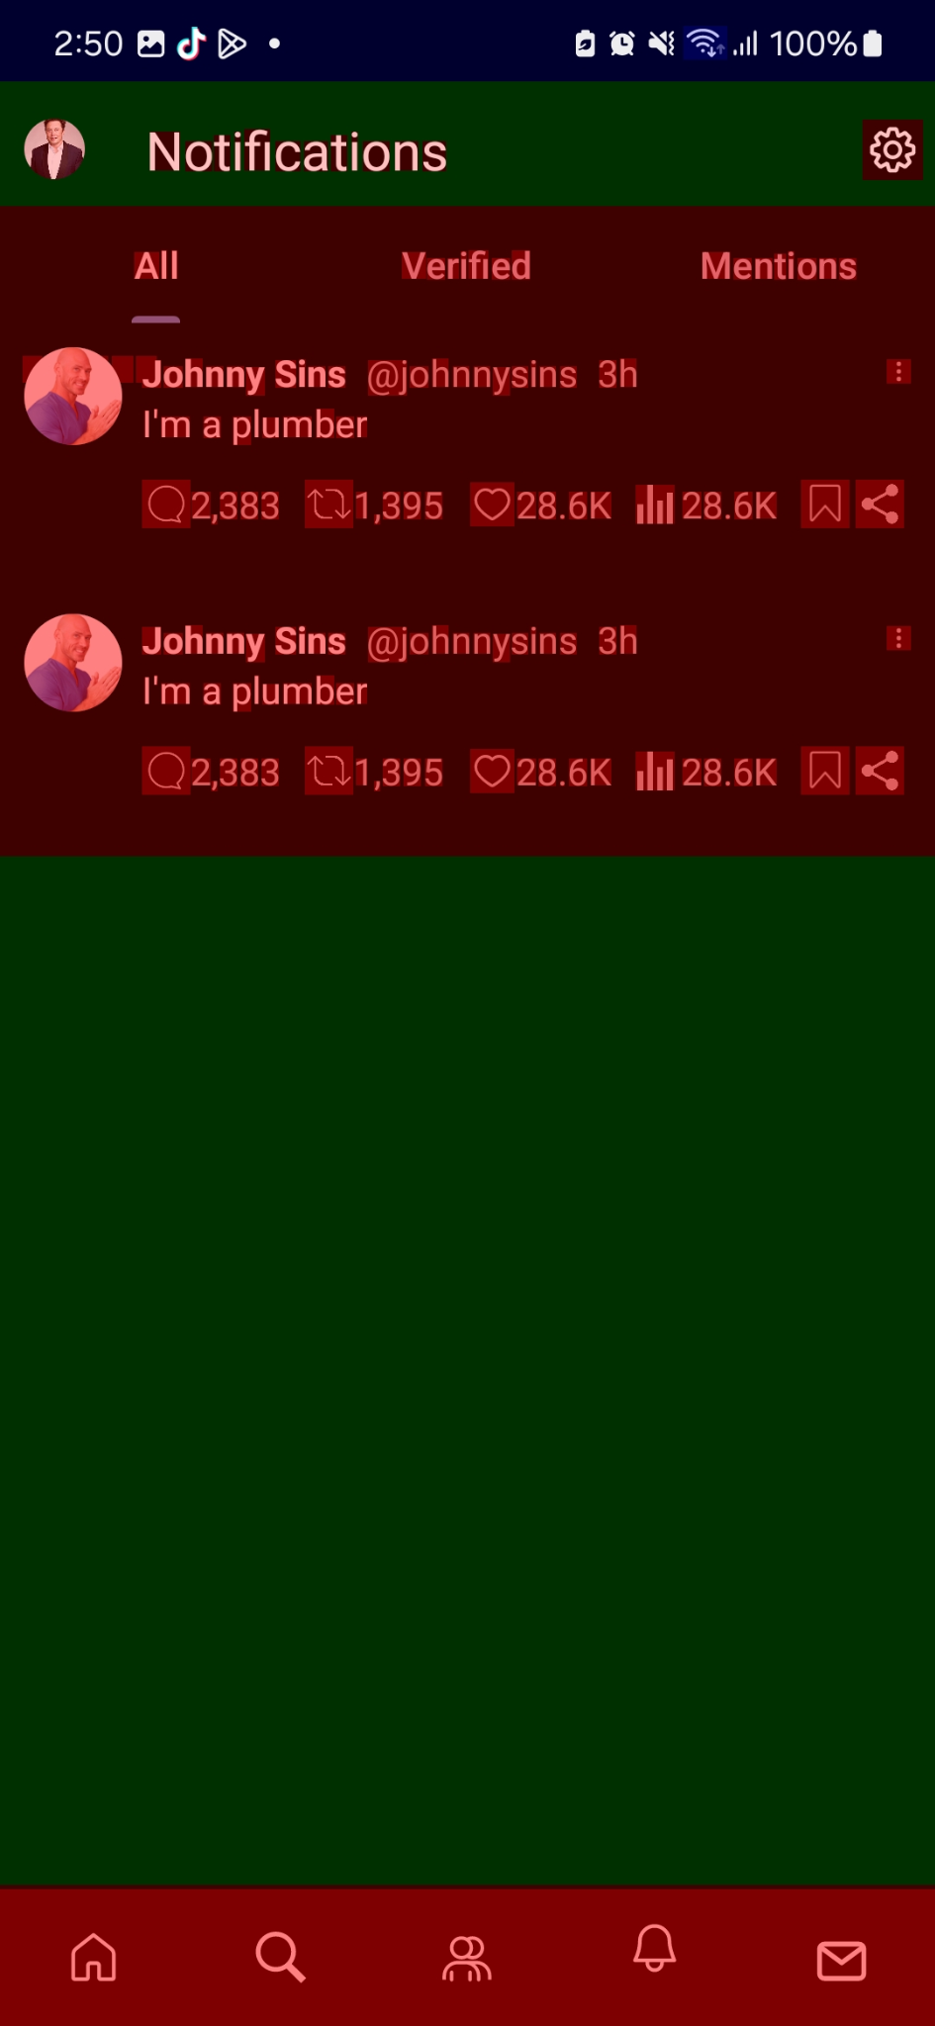
Overdraw:
Happens when the same pixel is drawn multiple times in a single frame, often due to overlapping UI elements. It can cause performance issues by wasting GPU resources.

Slide 19
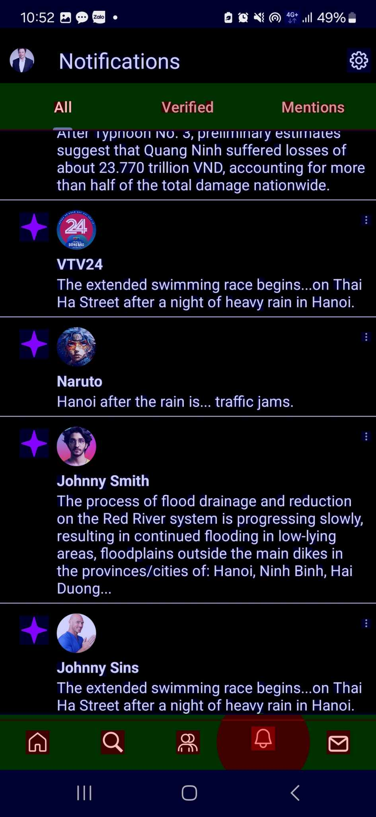
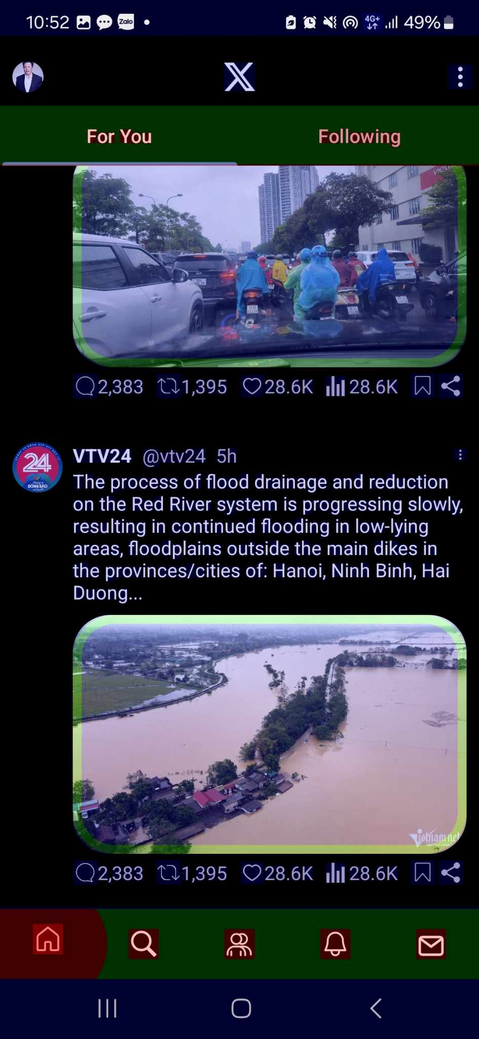
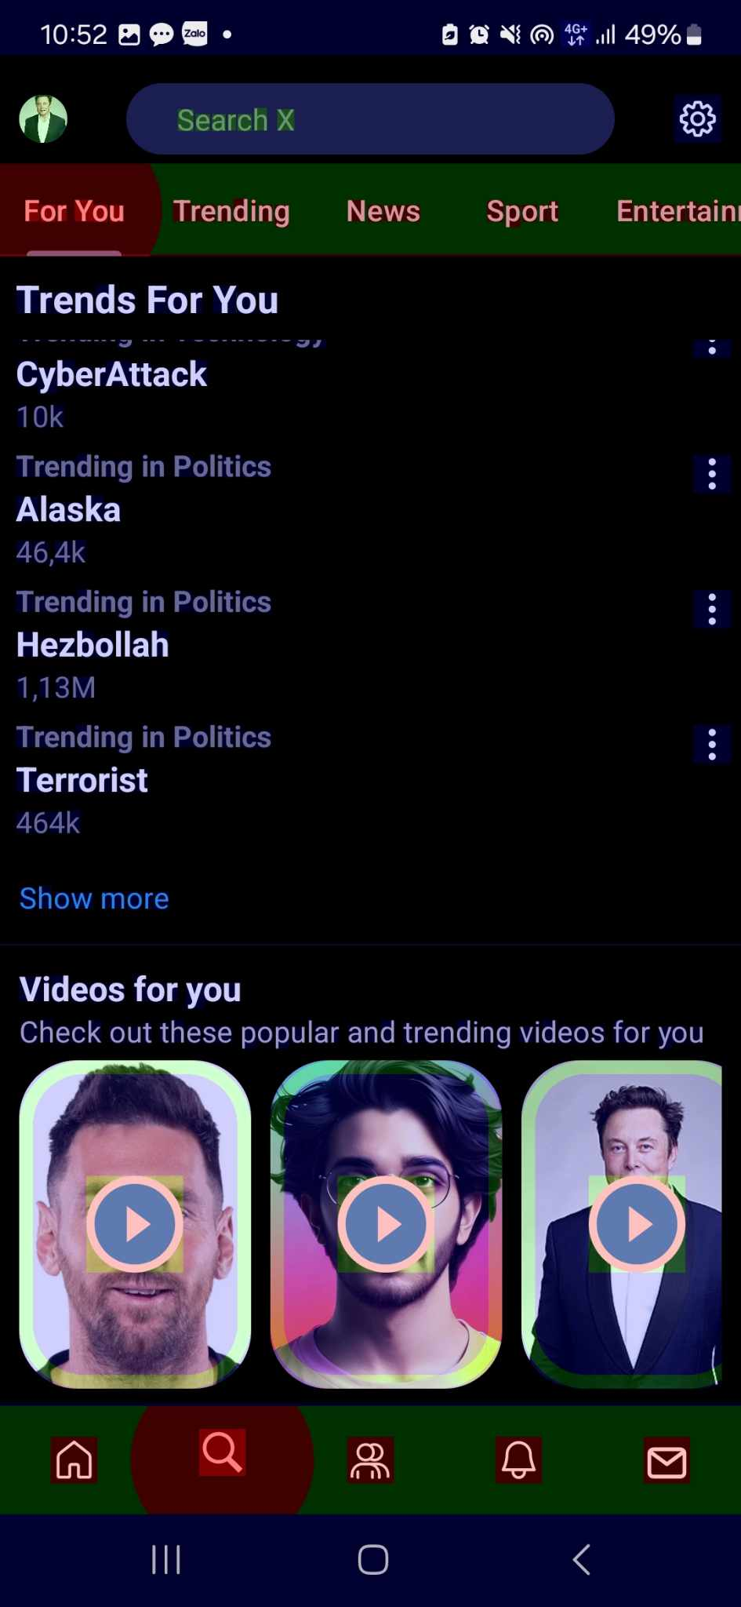
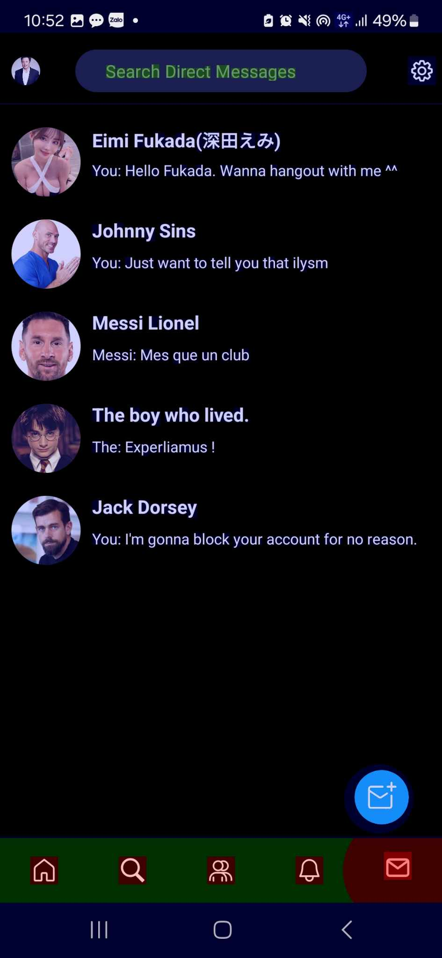
Solution:
Remove unnecessary backgrounds

Slide 20
05
Conclusion

Slide 22
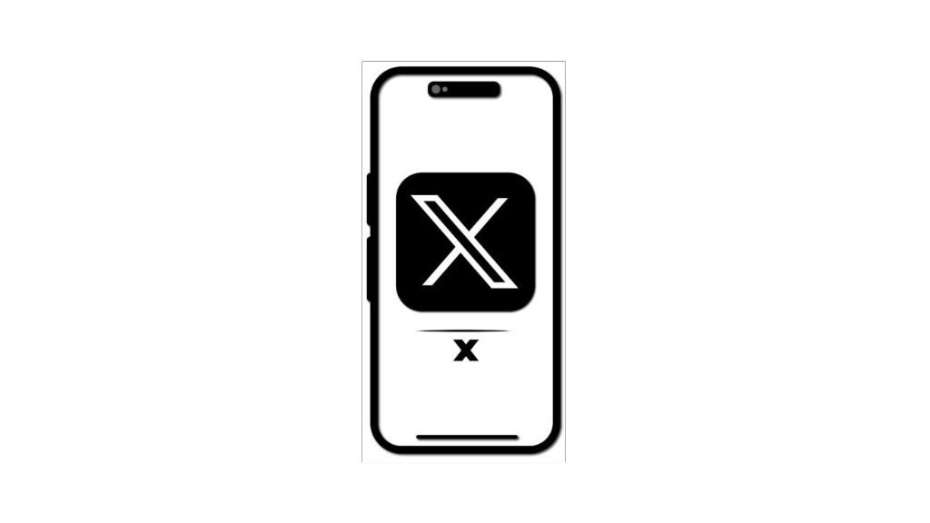
In The Future
Home: Can post video and interact user in real time
Community: Can post and filter categories in Communities
ChatBox: Interact with boxchat
Notification: Can interact in real time
Search: Search Bar for Future Queries

Slide 23
06
Demo

Slide 25
Thanks for listening!
Any question ?

